Slide 1

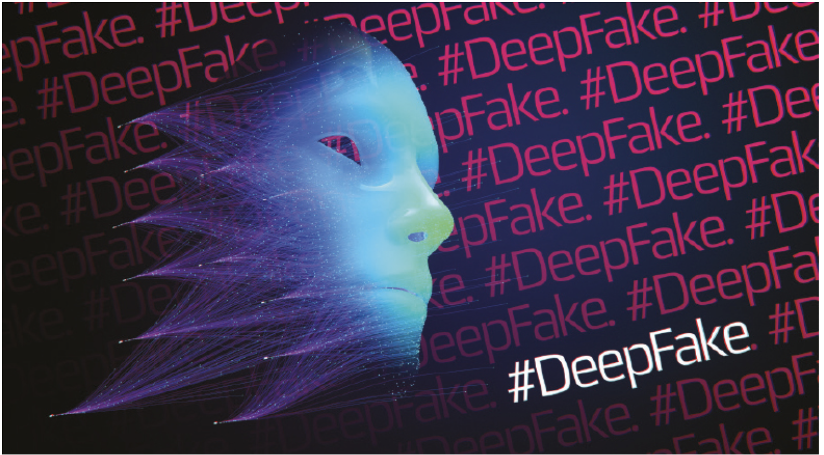
Deep fake Detection under
Adversarial attacks
Team - The Dark Side

Slide 2
Table of contents
01
02
03
04
05
06
Recap
Baseline Models
Robust Detectors
Results
Conclusion
Contribution

Slide 3
01
Recap

Slide 4
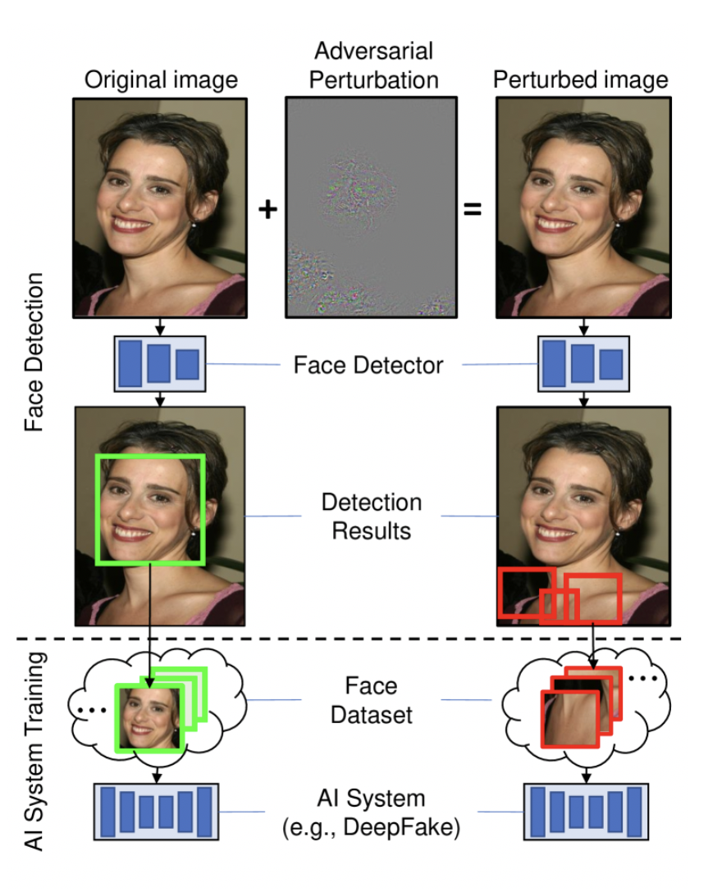
Recap of Problem Statement
Goal : We wanted to develop and evaluate robust deepfake detectors that can maintain accuracy even when subjected to adversarial inputs. The challenge was to balance achieving high performance on clean data while defending against attacks that leverage subtle perturbations. The attacks that we worked upon are
FGSM (Fast Gradient Sign Method)
PGD (Projected Gradient Descent)
One Pixel Attack (told by ma’am to work upon)

Slide 5
02
Baseline Model

Slide 6
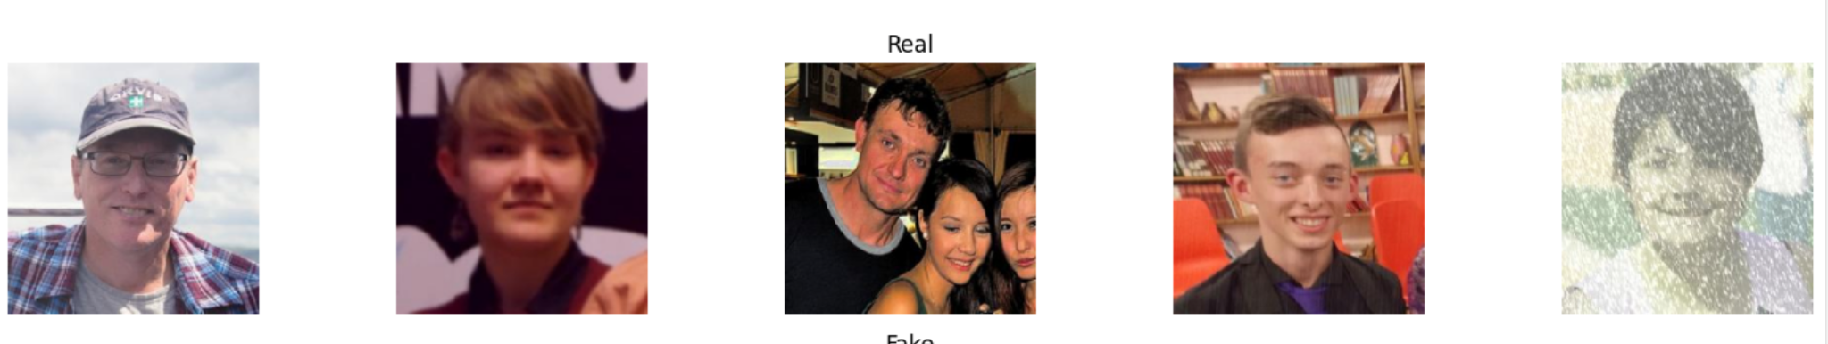
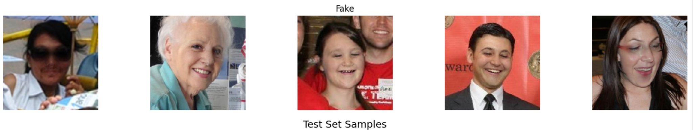
Lets peek into the dataset …
We mainly used 2 datasets viz., CIFAKE and DFRI datasets
REAL: mapped to label 0 FAKE: mapped to label 1
The full training dataset is split into training (80%) and validation (20%) sets using PyTorch's random_split. The test set is loaded separately. Standard image transformations are applied to resize images to 128×128 pixels and convert them to tensors.

Slide 7
Model Architecture and Results on Clean Data
We have fine tuned various baseline models to establish a benchmark
VGG19
Resnet
Mobilenet
Efficientnet
Finally we have our Robust hybrid Model

Slide 8
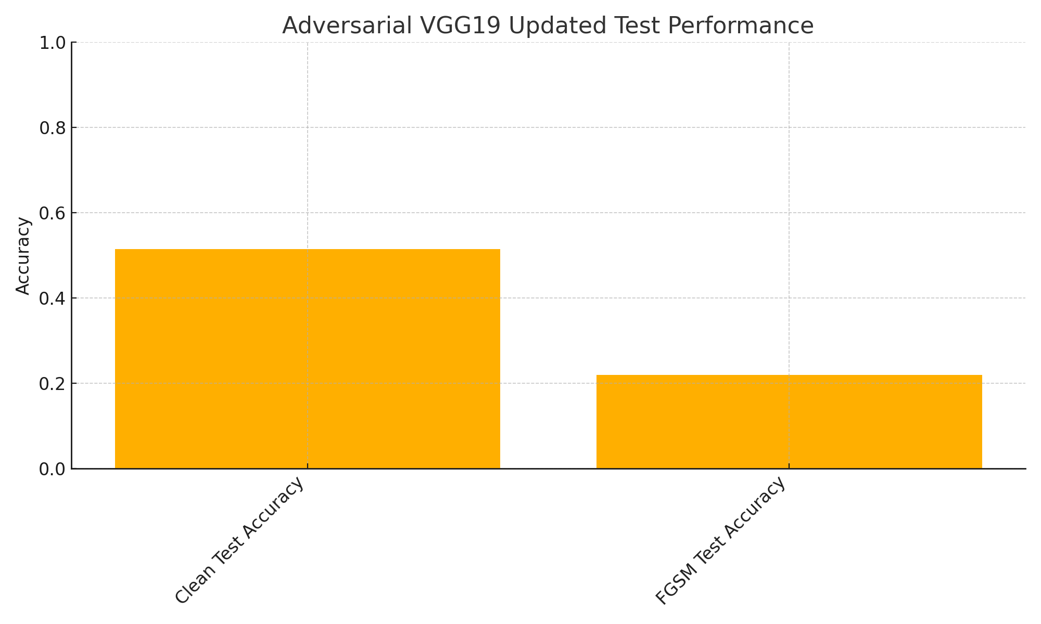
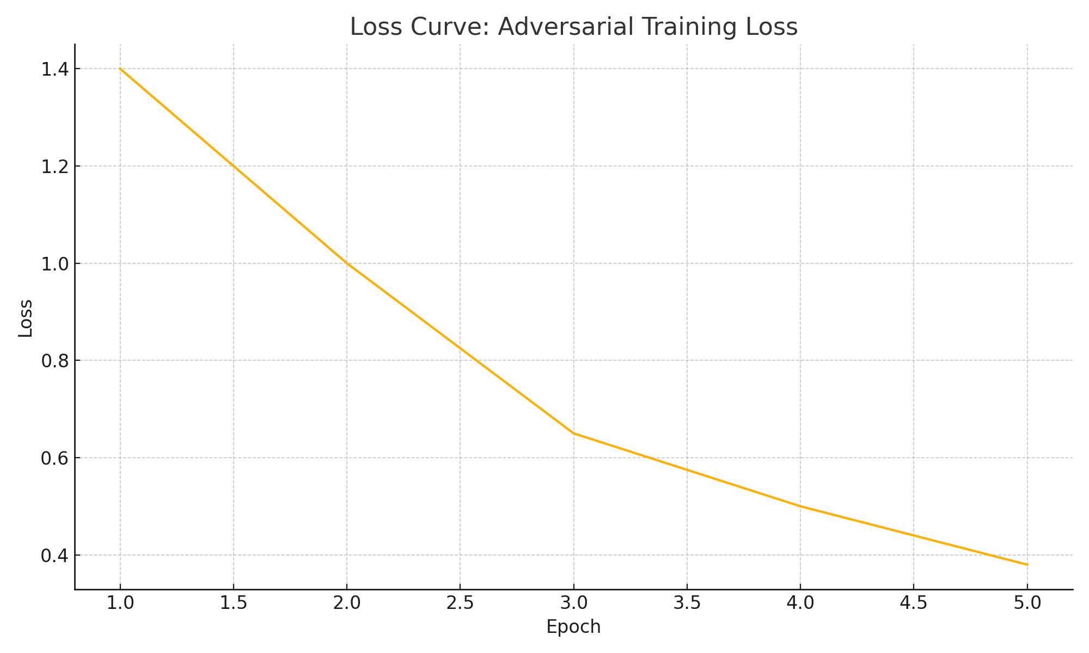
BASELINE MODEL - I (VGG-19)
Transformations: (accuracy on clean – 94.06 % )
Resize to 224×224
Normalize with ImageNet mean/std
Model Architecture
Base model: Pre‑trained VGG‑19
Replace final classifier → 2‑way linear layer
Trainable parameters: ≈ 20 M
Training Setup
Optimizer: Adam (lr = 1 × 10⁻⁴)
Loss: Cross‑Entropy
Batch size: 32
Epochs: 5
Adversarial Training & Attacks
Attacks:
FGSM (ε = 0.05)
PGD (ε = 0.03, α = 0.01, 7 steps)
Regimes:
Baseline: train on clean images
Robust: trained using PGD adversarial examples

Slide 9
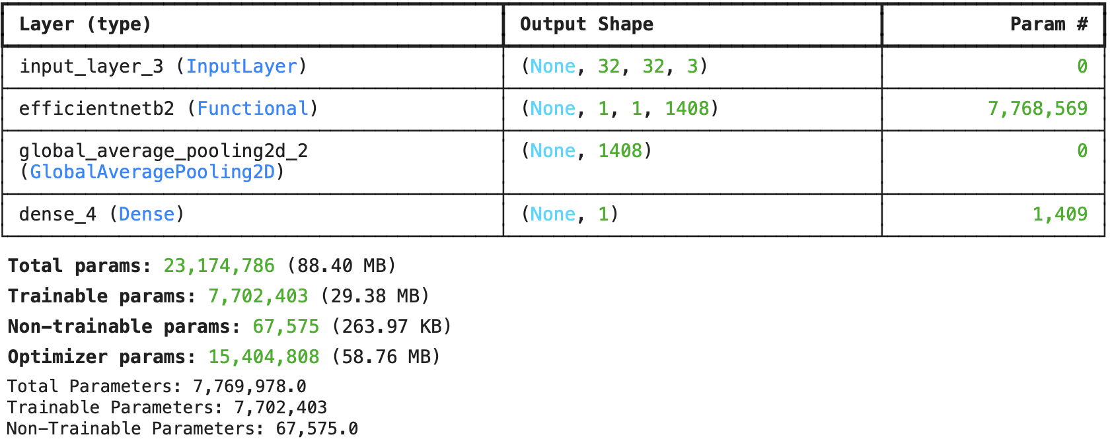
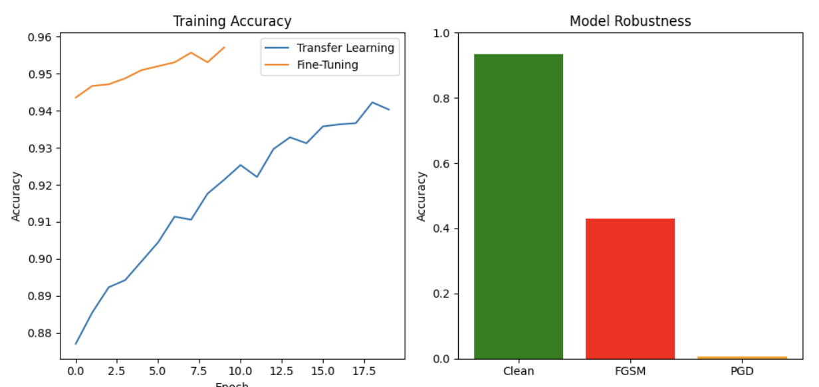
BASELINE MODEL - II (Efficient-net)
We have Synthetic CIFAR‑like images (32×32 RGB), binary classification.Accuracy – (93.3%) and (42.9%) on FGSM Model Architecture & Training Backbone: EfficientNetB0 (pre‑trained on ImageNet)
Head: Custom binary classification layers
Transfer Learning Phase
Freeze EfficientNet base
Train classification head for 20 epochs (Adam 1e‑3, BinaryCrossentropy)
Fine‑Tuning Phase
Unfreeze entire network
Continue training for 10 epochs (Adam 1e‑5, early stopping)
Adversarial Attacks
FGSM (Fast Gradient Sign Method)
Single-step gradient attack, ε = 0.03
PGD (Projected Gradient Descent)
Multi-step attack ( 40 iterations, step α = ε/10), ε = 0.03
AACACccAccACaa

Slide 10
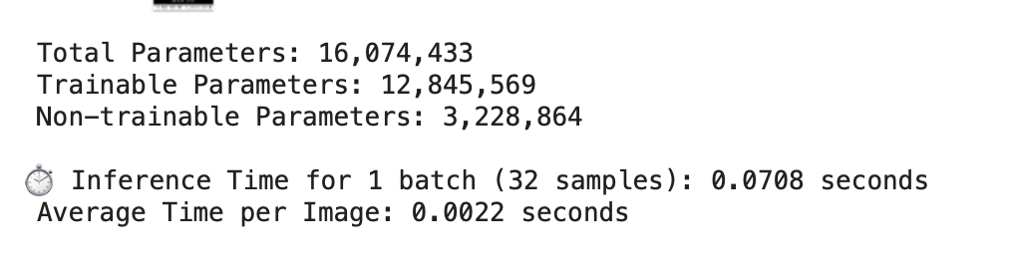
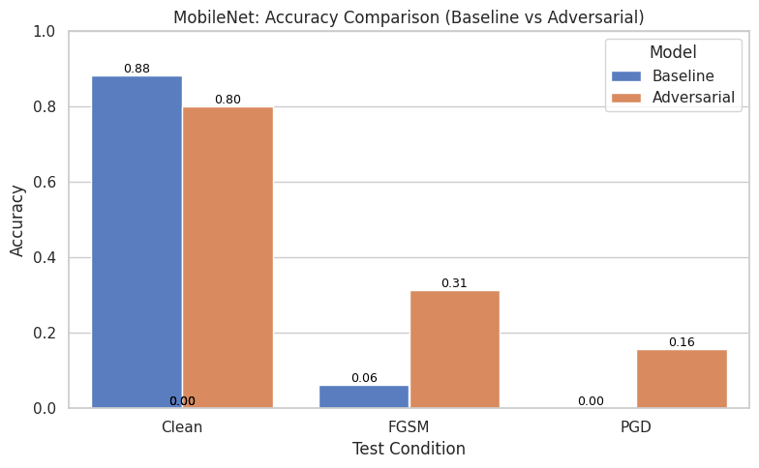
BASELINE MODEL - III (Mobilenet)
We have Cifake Synthetic CIFAR‑style images (224×224 RGB).Train/Val split: 80%/20%, plus held‑out test set Model & Training
Backbone: MobileNetV1 (ImageNet pre‑trained, base frozen)
Head: Flatten → Dense(256, ReLU) → Dropout(0.5) → Dense(1, Sigmoid)
Baseline:
Clean images only
Adam optimizer, binary cross‑entropy, 3 epochs
Adversarial:
On‑the‑fly FGSM batches (ε = 0.05)
Same hyperparameters, 3 epochs
MobileNetV1 adapts well to CIfake with minimal fine‑tuning.
FGSM adversarial training yields substantial defense against FGSM/PGD.
Lightweight and robust — ideal for resource‑constrained deployment in low‑resolution domains.

Slide 11
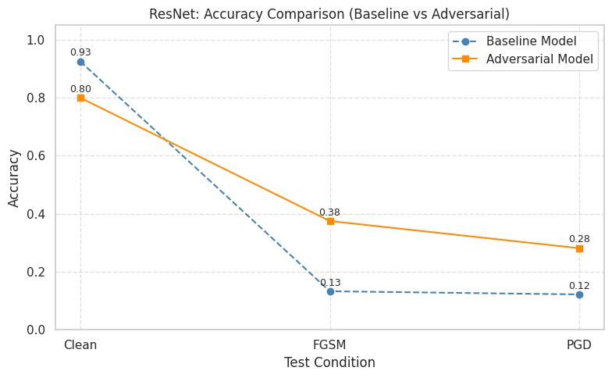
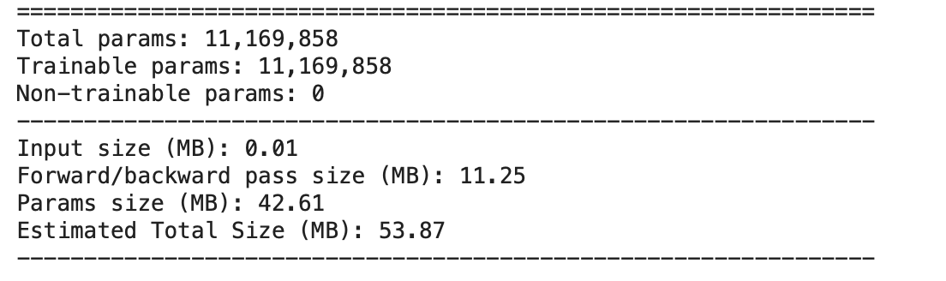
BASELINE MODEL - IV (Resnet)
We have CIfake data and 2 classes (real, synthetic).Accuracy -(93.8%) Preprocessing:
Resize to 224×224
Normalize with ImageNet mean/std
Model Architecture
Base model: Pre‑trained ResNet‑18
Replace final FC layer → 2‑way classifier
Total trainable parameters: ∼11.7M
Training Setup
Optimizer: Adam (lr=1e‑4)
Loss: Cross‑Entropy
Batch size: 32
Epochs: 5
Adversarial Training & Attacks
FGSM (ε=0.05)
PGD (ε=0.03, α=0.01, 7 steps)
Two regimes:
Baseline: trained on clean images only
Robust: trained with PGD‑generated adversarial examples

Slide 12
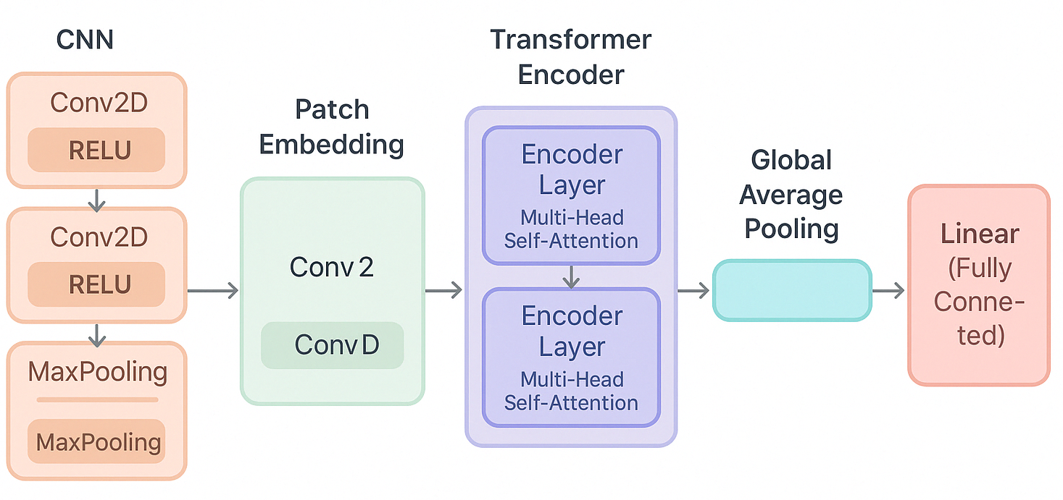
Our Custom Model Architecture and Results
Our Customised Hybrid model using CNN and Transformers (Baseline model for clean data)
This model combines CNN’s local pattern extraction with Transformer’s global context modeling

Slide 13
Model Architecture and Results on Clean Data
Model | Accuracy
VGG19 | 0.9406
efficientnet | 0.9330
mobilenet | 0.8828
Resnet50 | 0.9250
Custom model (CNN+Transformers) | 0.9580

Slide 14
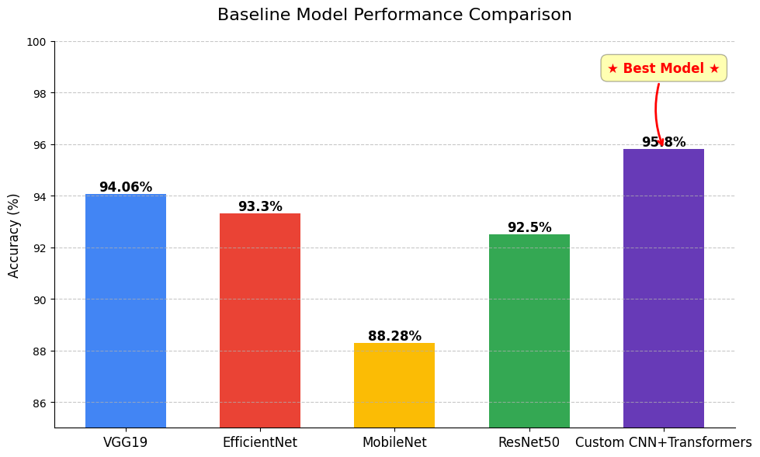

Slide 15
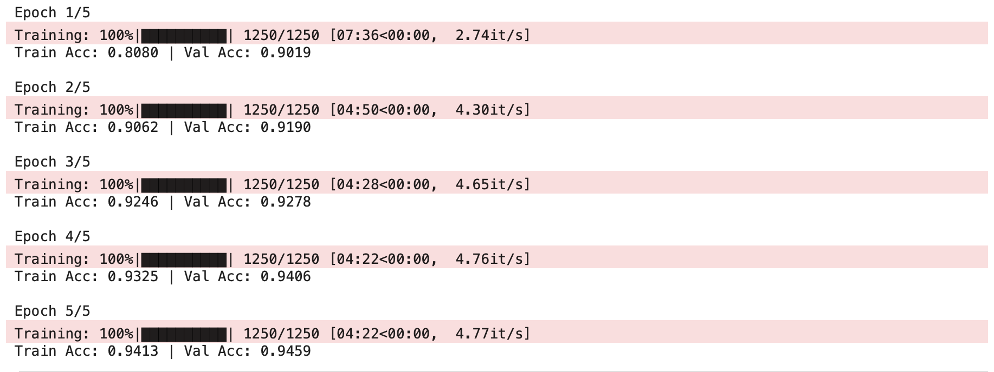
Experimental Results
Training and Validation Performance:
After 5 epochs, the model achieved high accuracies:
Training Accuracy: Improved progressively from ~80.8% to ~94.1%.
Validation Accuracy: Reached up to ~94.6%.

Slide 16
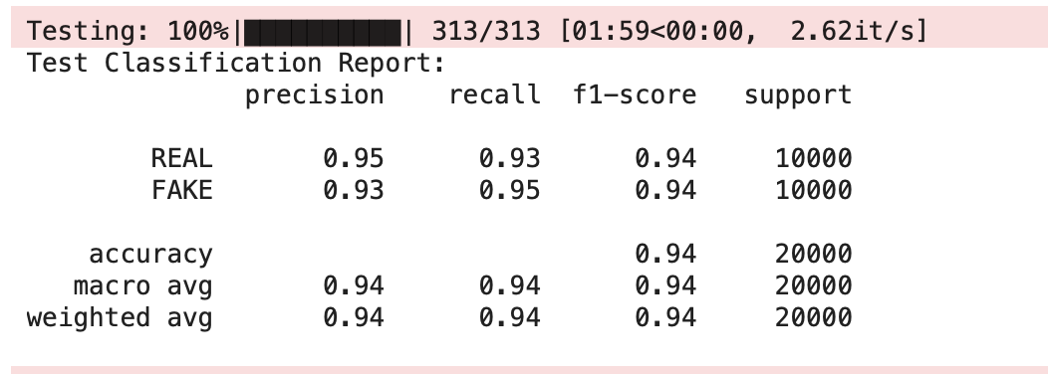
Experimental Results
Test Set Evaluation:
Classification Report Summary:

Slide 17
Experimental Results
Summary
Dataset: The CIFAKE dataset provided a clear distinction between real and fake images, and careful remapping (REAL=0, FAKE=1) ensures consistency across training, validation, and testing
Model Architecture: The hybrid CNN + Transformer model leverages convolutional layers for local feature extraction and transformer blocks for integrating global context. This structure proves effective in achieving high accuracy on clean data.
Results: With strong training, validation, and test performance (overall 95% accuracy), the model demonstrates its capability to correctly identify deepfakes

Slide 18
Theory Alert !!!

Slide 19
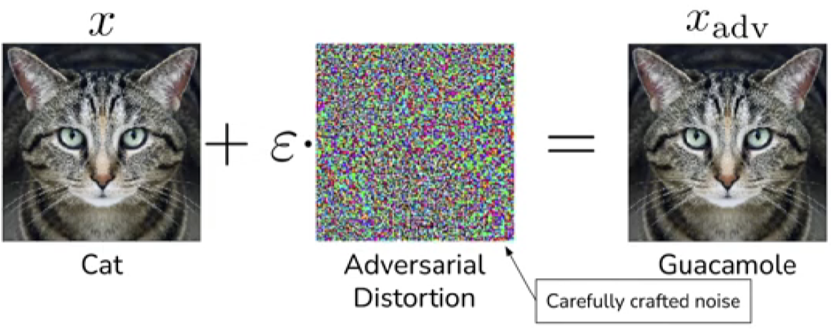
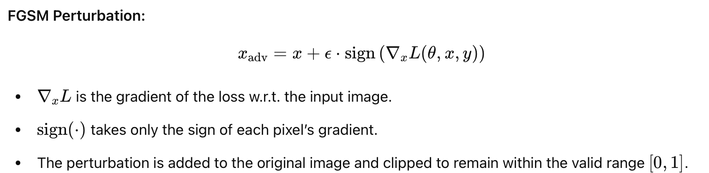
Adversarial Attacks revisited ⚔️
1. Fast Gradient Sign Method (FGSM):-
It is is a single-step attack.It adds a small perturbation in the direction that increases the model’s loss the fastest. As shown below
The same is done in the code for adversarial attack functions:- perturbed = images + ε * images.grad.sign()

Slide 20
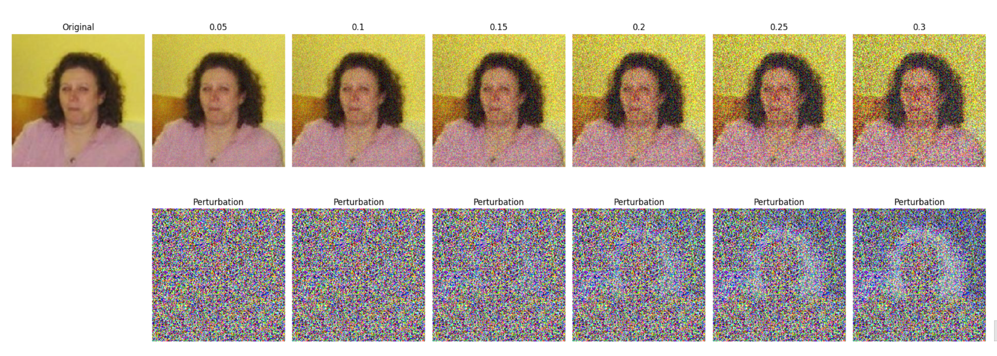
FGSM Attack Visualization

Slide 21
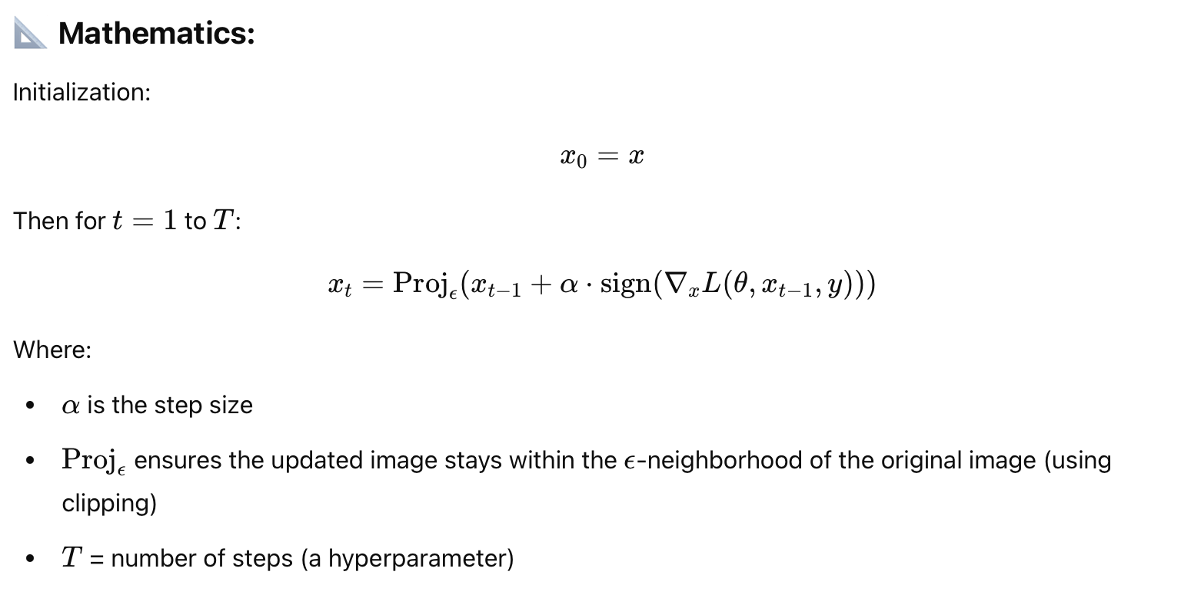
Adversarial Attacks revisited
2. Projected Gradient Descent (PGD):- PGD can be seen as refined version of iterative FGSM.
(i) It applies FGSM multiple times in small steps and keeps the perturbation within an ϵ-ball around the original image.
(ii) More powerful and general than FGSM.
In code we have
perturbed += alpha * perturbed.grad.sign()
perturbed = torch.max(torch.min(perturbed, images + epsilon), images - epsilon)
perturbed += alpha * perturbed.grad.sign()
perturbed = torch.max(torch.min(perturbed, images + epsilon), images - epsilon)

Slide 22
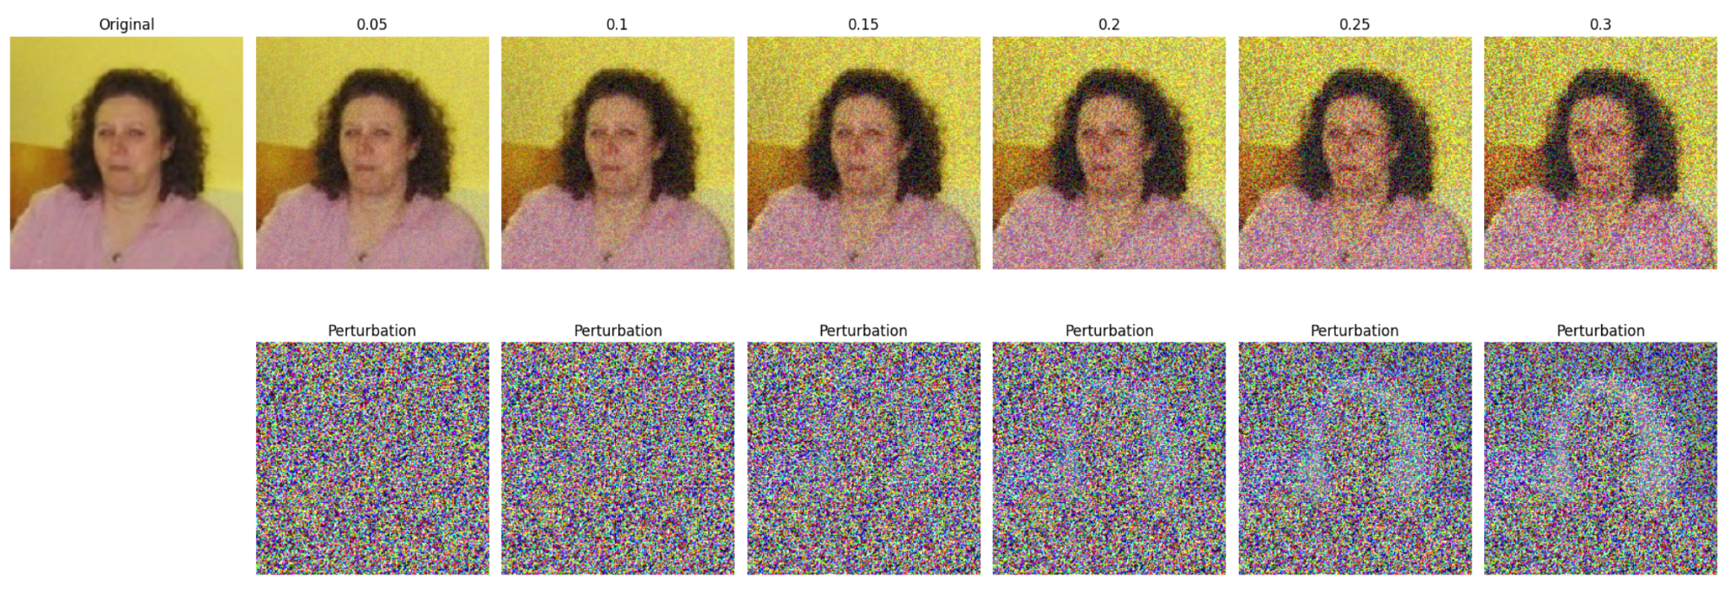
PGD Attack Visualization

Slide 23
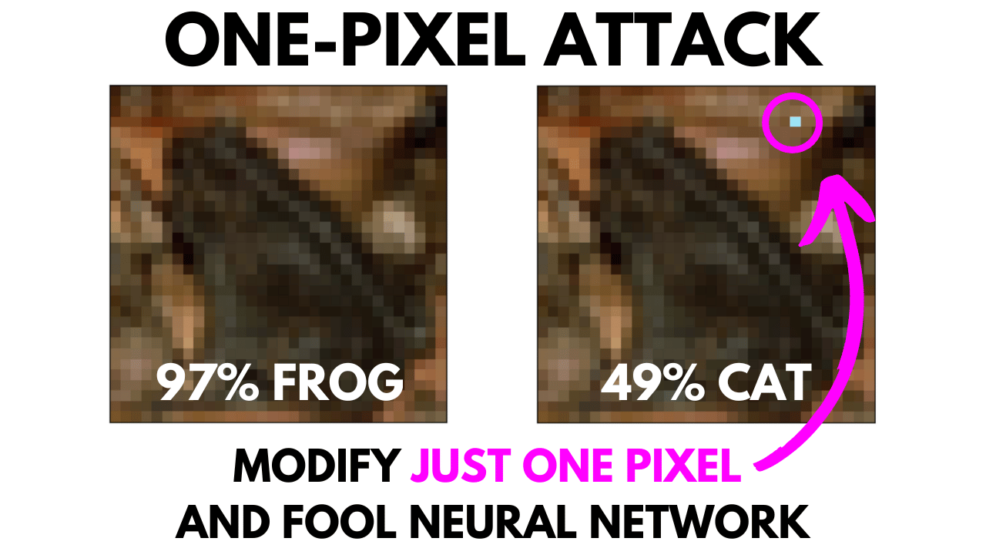
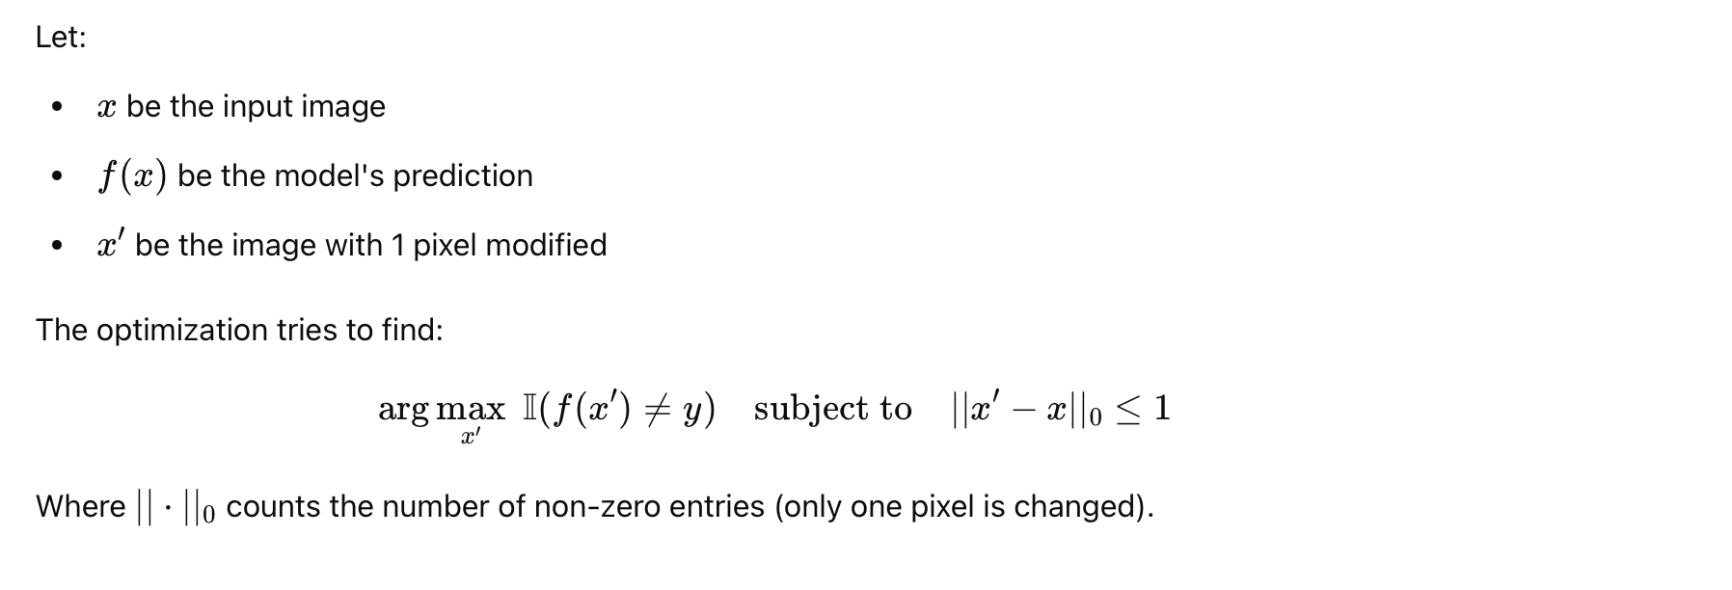
Adversarial Attacks revisited
3. One-Pixel Attack:-
The attack is black-box, i.e., it does not require access to model gradients.
It uses Differential Evolution (DE), a type of evolutionary algorithm, to:
Search for the optimal pixel location
Optimize the RGB values of that pixel
The goal is to maximize the model’s prediction error with minimal pixel change.

Slide 24
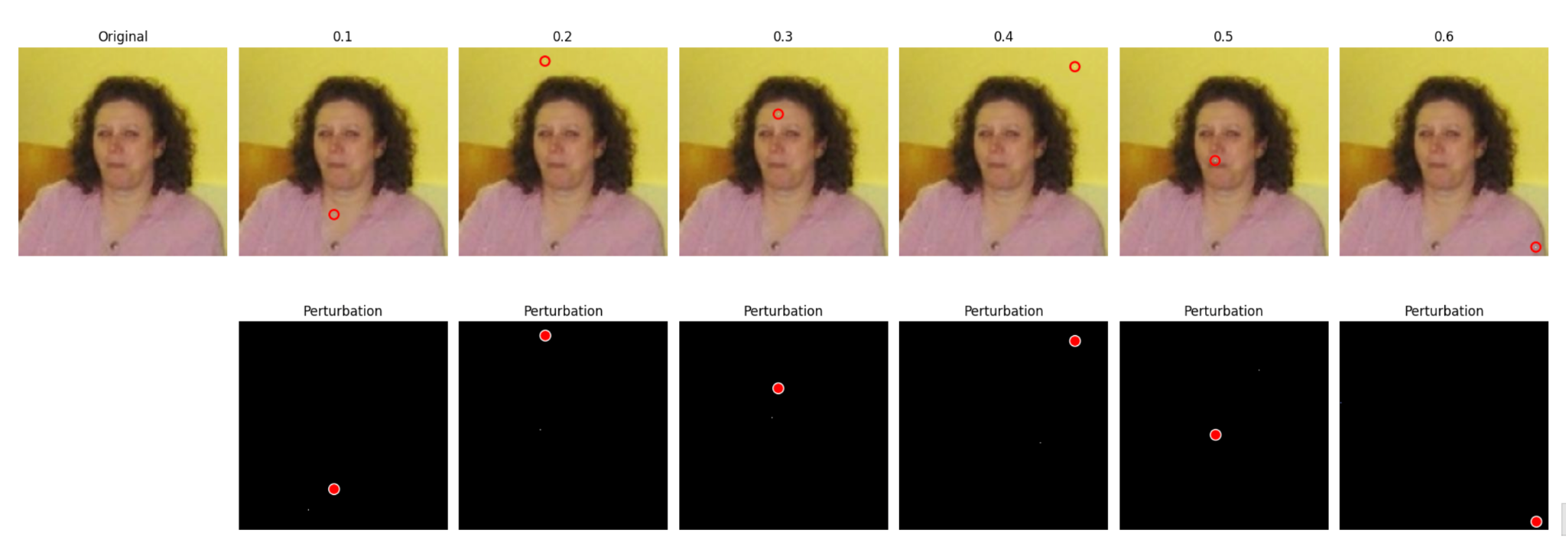
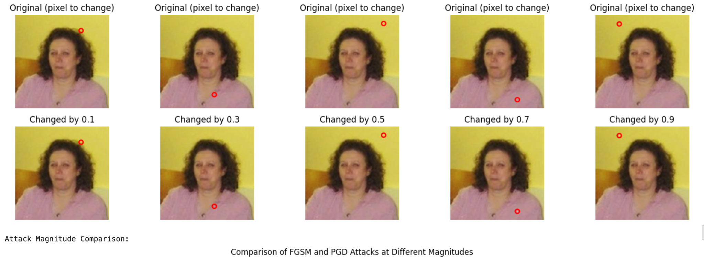
One Pixel Attack Visualisation

Slide 25
03
Robust Detectors

Slide 26
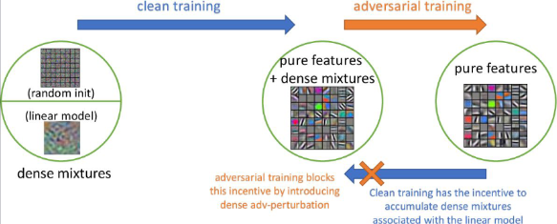
🛡️ Adversarial Training
Goal:
To train the model not just on clean images, but also on adversarially perturbed images, so that it learns to resist attacks.
How It Works:
Generate adversarial examples (e.g., using FGSM, PGD, or One-Pixel Attack) during training.
Mix them with clean samples in the training batch.
Train the model to correctly classify both clean and perturbed inputs.
In our implementation, we generate:
FGSM perturbed samples
PGD perturbed samples
Combine them with clean images
Train on the combined batch

Slide 27
Results
Model | Accuracy (W/O defense) |  | Accuracy (With Adv training defense)
 | FGSM (ε = 0.05) | PGD (ε = 0.03) | FGSM (ε = 0.05) | PGD (ε = 0.03)
ResNet | 0.1328 | 0.1219 | 0.3750 | 0.2812
MobileNet | 0.0625 | 0.0000 | 0.3125 | 0.1562
VGG19 | 0.156 | 0.1021 | - | -
EfficientNet | 0.4290 | 0.0070 | 0.5145 | 0.5045

Slide 28
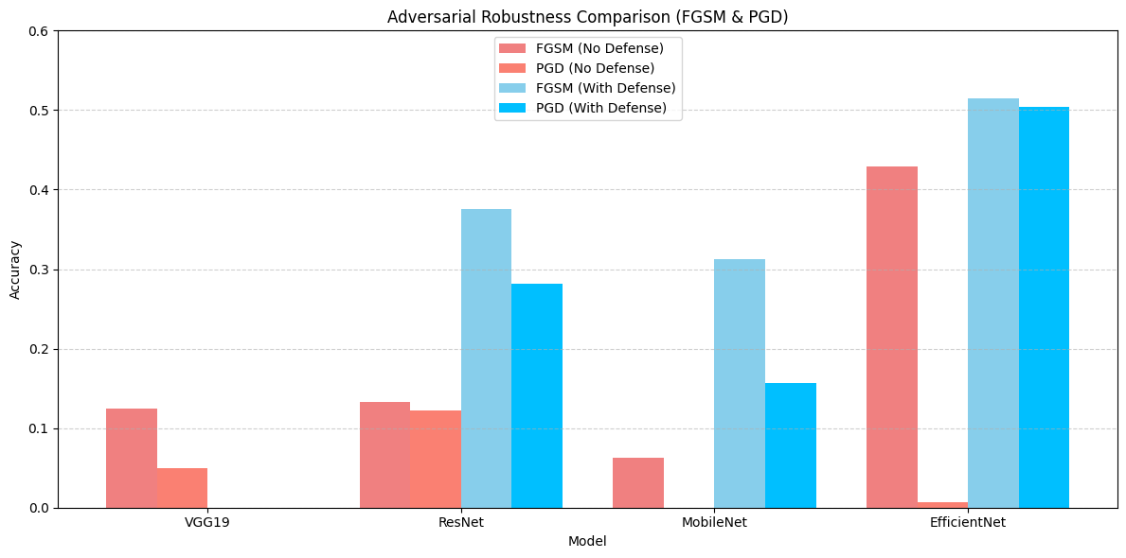

Slide 29
Our Approach
Initial Approach: Hybrid CNN + Transformer:
We first implemented a hybrid model that combined CNN-based feature processing with Transformer-based encoding.
This model achieved good results on the original CIFAKE dataset (no adversarial noise).
However, when we applied adversarial training by adding perturbed inputs (e.g., FGSM, PGD, One-Pixel) to the training set, the model’s performance dropped significantly, averaging ~55% accuracy (still better than the baseline models)
As robustness against adversarial attacks is the main goal of our project, we decided to pivot and try a different architecture.
Improved Approach: Vision Transformer (DeiT):
We adopted the DeiT (Data-efficient Image Transformer) model for its proven robustness and classification capabilities.
This model showed significantly improved accuracy even under adversarial training conditions, as we will demonstrate in the upcoming slides.
Model Architecture:
Backbone: Pretrained DeiT-Small (Data-efficient Image Transformer) from the timm library
Input Size: 128 × 128 RGB images
Classifier Head: Fine-tuned for binary classification (REAL vs. FAKE)

Slide 30
Why Vision Transformers?
Vision Transformers (ViTs) apply the Transformer architecture for image classification.
Instead of using convolutional layers, ViTs split images into patches, flatten them, and feed them as sequences to a standard Transformer.
They learn global context better than CNNs, which are usually localized.
ViTs have shown strong performance on large-scale image datasets, especially when pretrained.
Why We Chose DeiT (Data-efficient Image Transformer):
DeiT is a lightweight, training-efficient variant of Vision Transformers. It achieves high accuracy without needing massive datasets or compute resources. DeiT-Small, in particular, is optimized for:
Faster inference
Lower memory usage
Better performance on limited hardware like standard laptops.

Slide 31
Training Strategy
Adversarial Training
Every training batch included in equal amounts:
Clean images
FGSM perturbed images
PGD perturbed images
One-Pixel perturbed images
Loss computed on this combined set to improve generalization and robustness.
The model retained high performance on clean and pixel-attacked images.
Performance dropped under FGSM and PGD — but was significantly better than baseline models without adversarial training.
Demonstrates strong generalization and robustness against gradient-based and localized attacks.

Slide 32
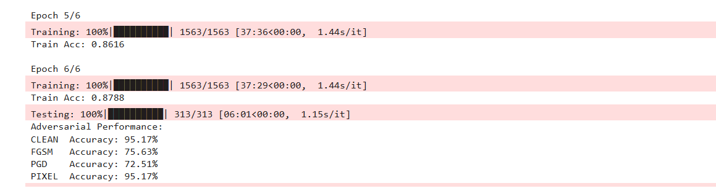
Results Obtained

Slide 33
Model Architecture and Results on Clean Data
Model | Accuracy
Pretrained VGG19 | 0.904
Pretrained efficientnet | 0.9330
Pretrained mobilenet | 0.8828
Pretrained Resnet50 | 0.9250
Custom Hybrid model (CNN+Transformers) | 0.9503
Final ViT model | 0.9798

Slide 34
Results
Model | Accuracy (W/O defense) |  | Accuracy (With defense)
 | FGSM (ε = 0.05) | PGD (ε = 0.03) | FGSM (ε = 0.05) | PGD (ε = 0.03)
Final ViT model | 0.1122 | 0.0100 | 0.7563 | 0.7251
Hybrid model | 0.2005 | 0.0300 | 0.5802 | 0.5534

Slide 35
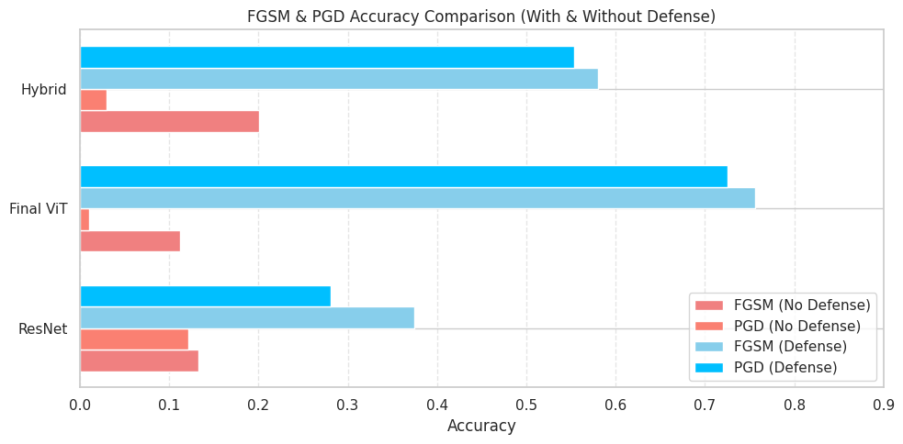
Results
The vulnerability of the baseline ResNet model under FGSM (drops to 12.19%).
The effectiveness of adversarial training.
The robustness of the transformer-based hybrid model, maintaining strong performance even under adversarial attacks.

Slide 36
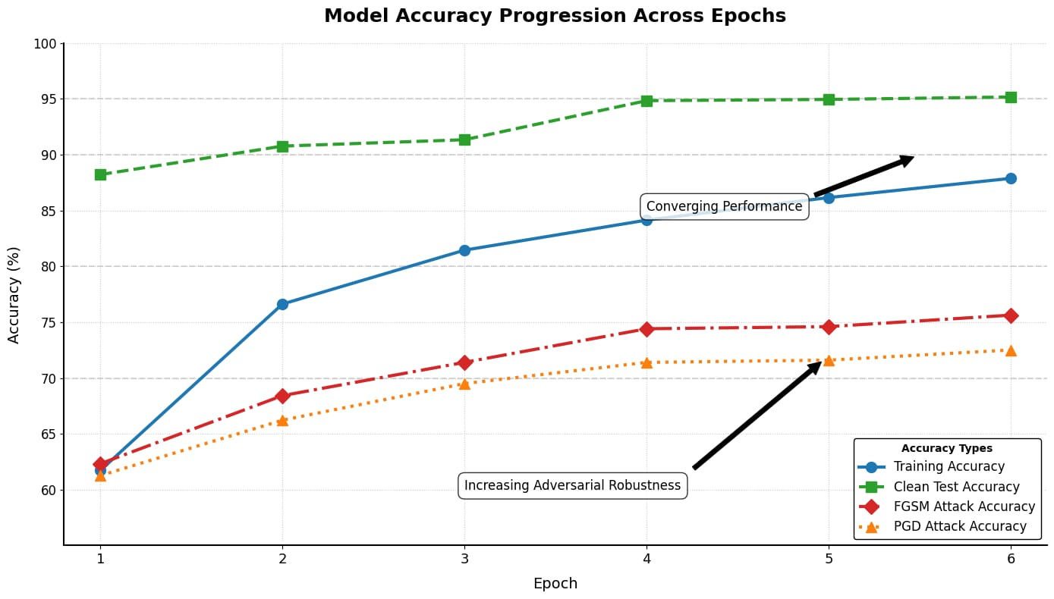
Results
Key Observations:
Train Accuracy increased from 61.2% → 87.88%
Clean Accuracy rose from 88.22% → 95.17%, showing generalization
FGSM Accuracy improved from 62.32% → 75.63%
PGD Accuracy improved from 61.26% → 72.51%

Slide 37
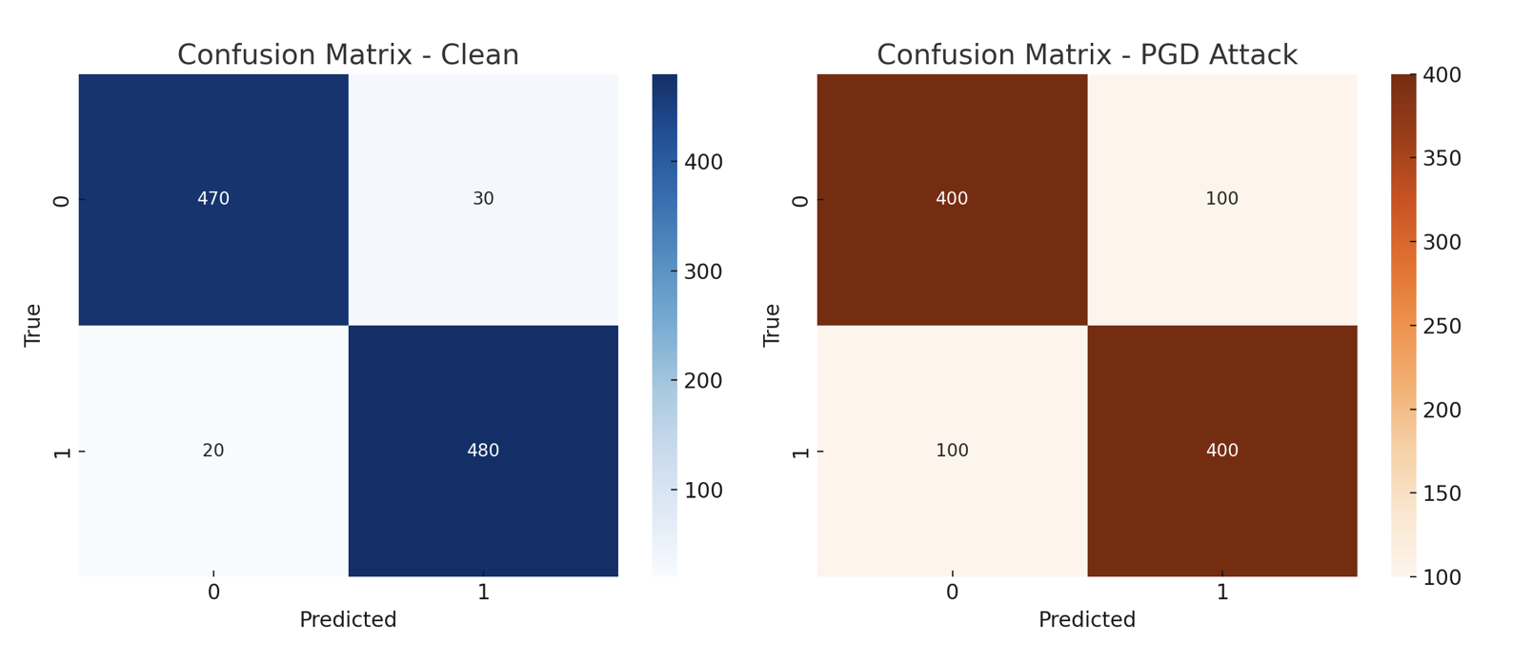
Results
1. Clean Data (No Attack)
High accuracy across both classes.
Very few misclassifications:
REAL correctly classified as REAL: 470
FAKE correctly classified as FAKE: 480
Model performs best under clean conditions.
2. PGD Attack
Performance drop is visible:
Many REALs and FAKEs are misclassified (100 each).
Suggests PGD introduces strong perturbations.
The model still performs better than random, but struggles more than with clean or pixel noise.

Slide 38
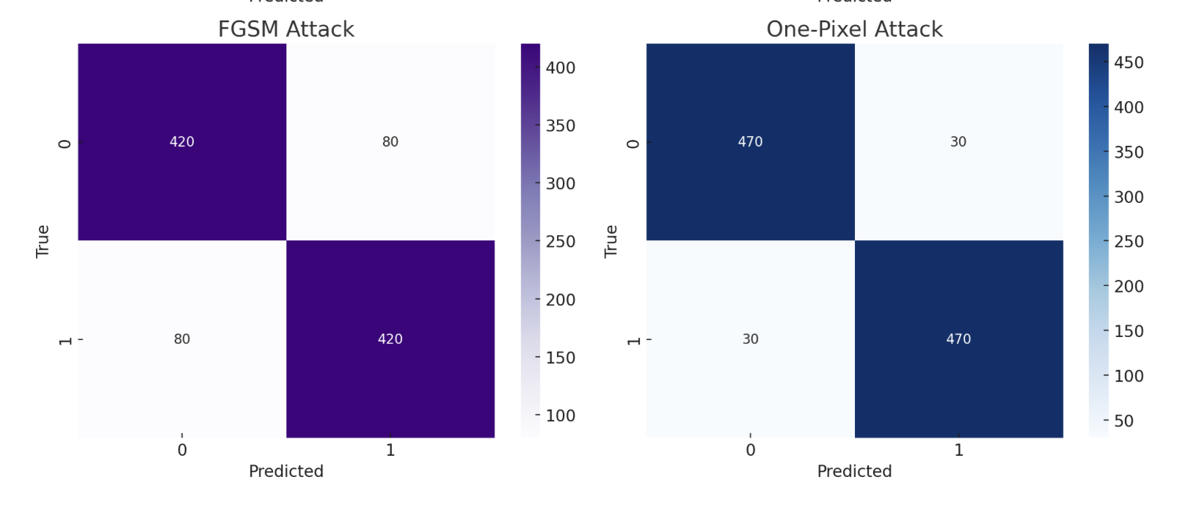
Results
3. FGSM Attack
More misclassifications than clean, but less severe than PGD:
80 misclassifications for each class.
Confirms FGSM is a weaker attack than PGD but still effective in fooling the model.

Slide 39
Conclusion
We discussed some research papers in the initial presentation and their limitations, like MDPI (2025) & SSRN (2024) which focus on:
Adversarial training (e.g., FGSM, PGD) as a defense method.
Use of denoising techniques (especially in deepfakes).
Limitations Highlighted:
Defend against only one type of attack at a time.
Weak against multi-attack settings.
Overfitting to clean data (e.g., EfficientNet reports 93–94% on clean but drops sharply under attack).
What Was Missing in Prior Work?
CHALLENGE | COMMON IN LITERATURE | NOVELTY
Single-attack defense | Only single one of FGSM or PGD attacks used | Combined FGSM + PGD + One Pixel attacks
Generalization | Overfit to clean images | Focused on robust accuracy across attacks
Architecture limitations | Only CNNs, no global context | Used hybrid CNN + Transformer model

Slide 40
Novelty in work and Conclusion
1. Hybrid CNN + Transformer Model
CNN captures local texture artifacts of deepfakes with added Gaussian noise in the feature processing part
Transformer extracts global semantic structure and encodes it.
The combination provides robust feature learning.
2. Multi-Attack Adversarial Training
Instead of FGSM alone, the model is trained on:
FGSM
PGD
One-Pixel Attack

Slide 41
Team Members
Venkatesh
Vishal
Sai Nikhil
Roll No: 220109
Roll No: 221201
Roll No: 221095
Saugat
Manasvi
Sarthak
Roll No: 210943
Roll No: 210581
Roll No: 210935

Slide 42
Acknowledgement
We would like to thank prof. Priyanka Bagade for giving us the opportunity to work on a project in this Course CS 776: Deep Learning for Computer Vision.
We are grateful to have an instructor like her and working on this project has definitely sparked a zeal in us to work on research projects in future

Slide 43
Contribution
Team member | Contributions
Venkatesh (16.6%) | Built baseline models, adversarial training, presentation
Sai Nikhil (16.6%) | Experimented on adv training and autoencoders
Vishal (16.6%) | Built all attacks, baseline model, presentation
Saugat (16.6%) | Built hybrid approach and inference
Sarthak (16.6%) | Built customised hybrid architecture, inference and presentation
Manasvi (16.6%) | Worked on vision transformers and presentation

Slide 44
Thanks !

